Slide 1

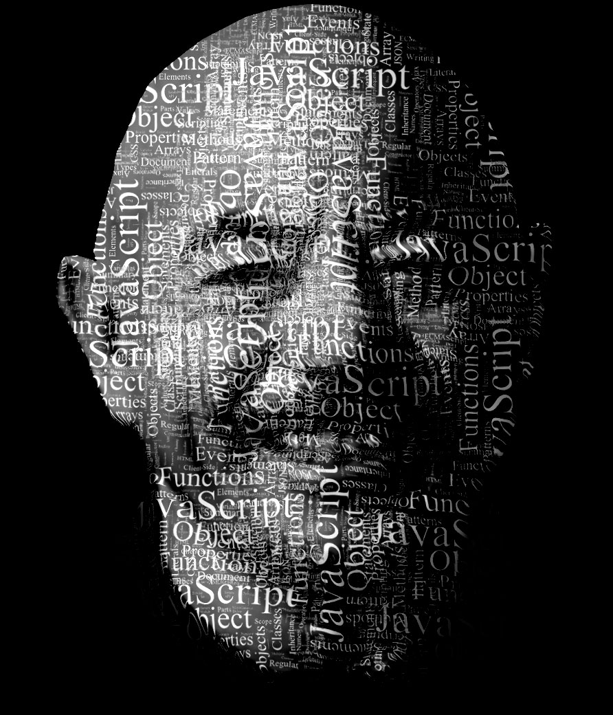

1.00
Applied Computation
& Data Science
7 BILLION PEOPLE
200 COUNTRIES
ALL PRODUCING DATA

Slide 2
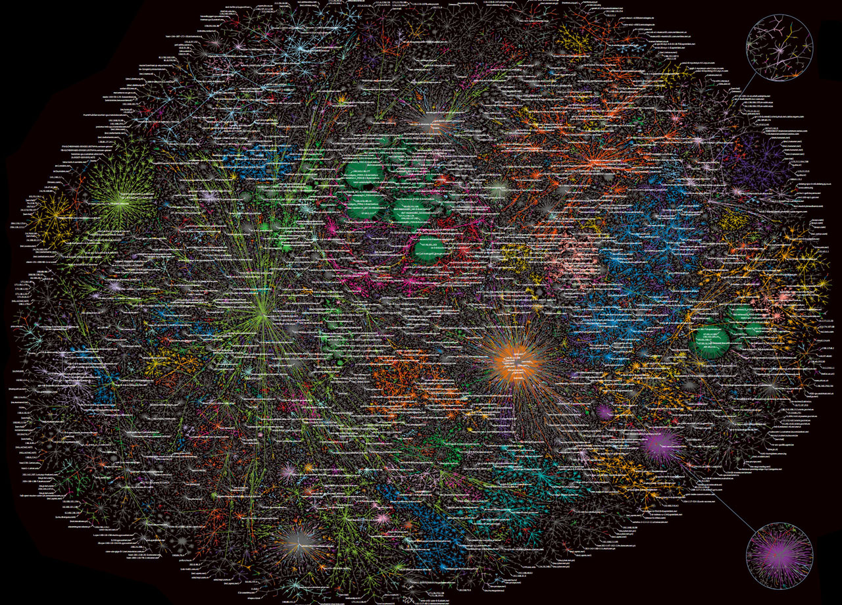
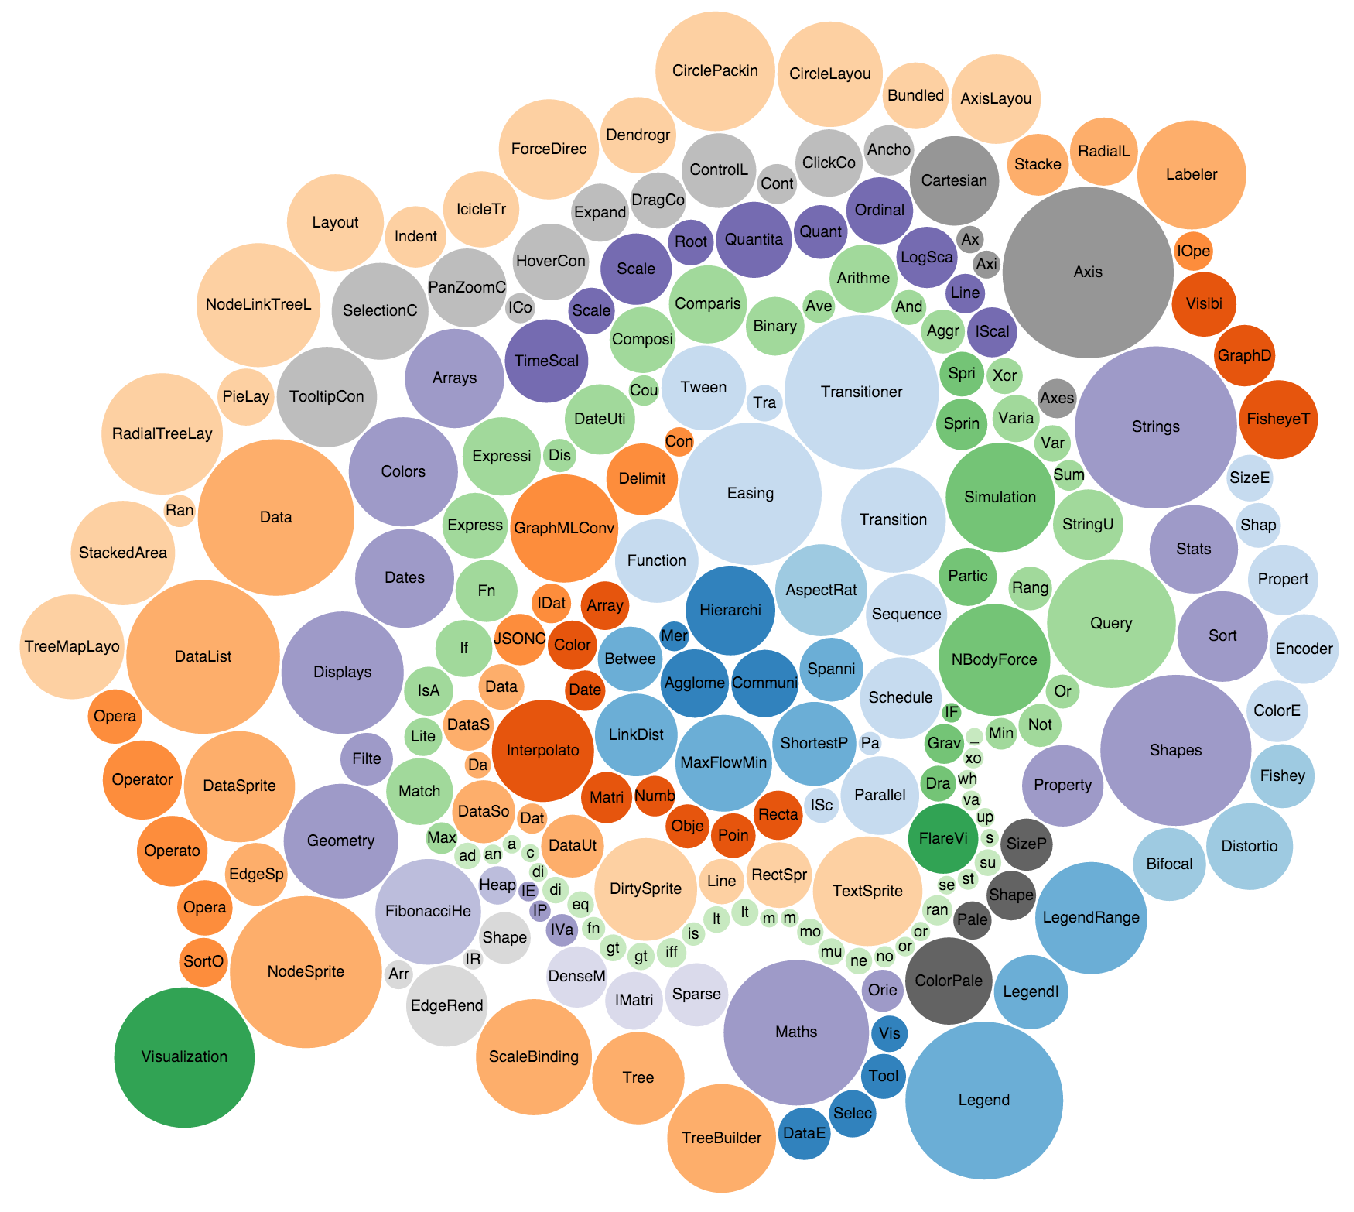


Big Data
Web Platform/IOT
Visualization
Machine Learning

Slide 3
Applied Computation and Data Science
Learning Outcomes
By the end of this course you will understand
Why computation is important
Why data science and data visualization are important
The basics of JavaScript and how to use it in Web Computing. You will understand how to get data from remote web sites, how to process and filter that data into a form suitable for analysis and visualization.
How to debug and validate code
How to walk through JSON data and extract target objects.
How to using Google Charts, canvas and D3 for visualizing data sets.
The basics of Data Science including, K-clustering, linear regression, Bayesian belief networks, neural networks, including simple machine learning, flocking and physics of social network.
Basics of geo-spatial mapping

Slide 4

Example video

Slide 5
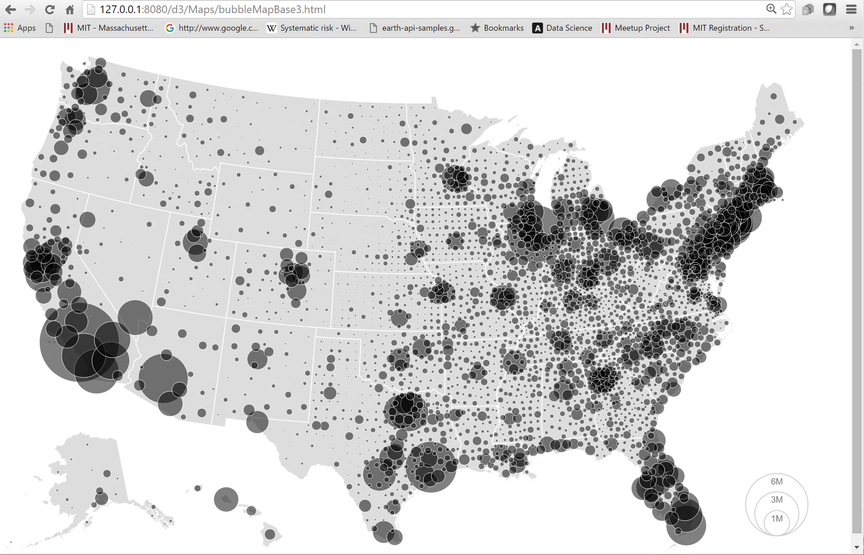
Map of USA with population bubbles

Slide 6

Start - 1 Week On-Site

Slide 7

13 Weeks – Lectures Delivered Online

Slide 8
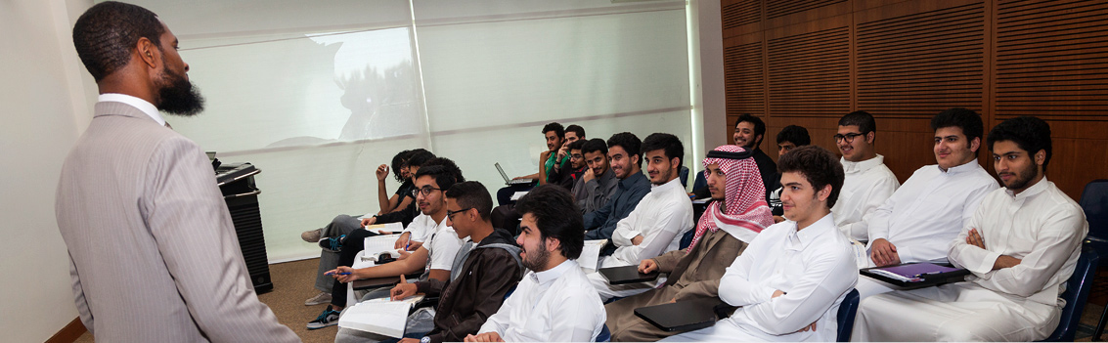
Local Teaching/HW/Quiz/Project
1 Professor
1 Teaching Assistant for Every 15 Students
1 Lecture Assistant for Every 15 Students

Slide 9
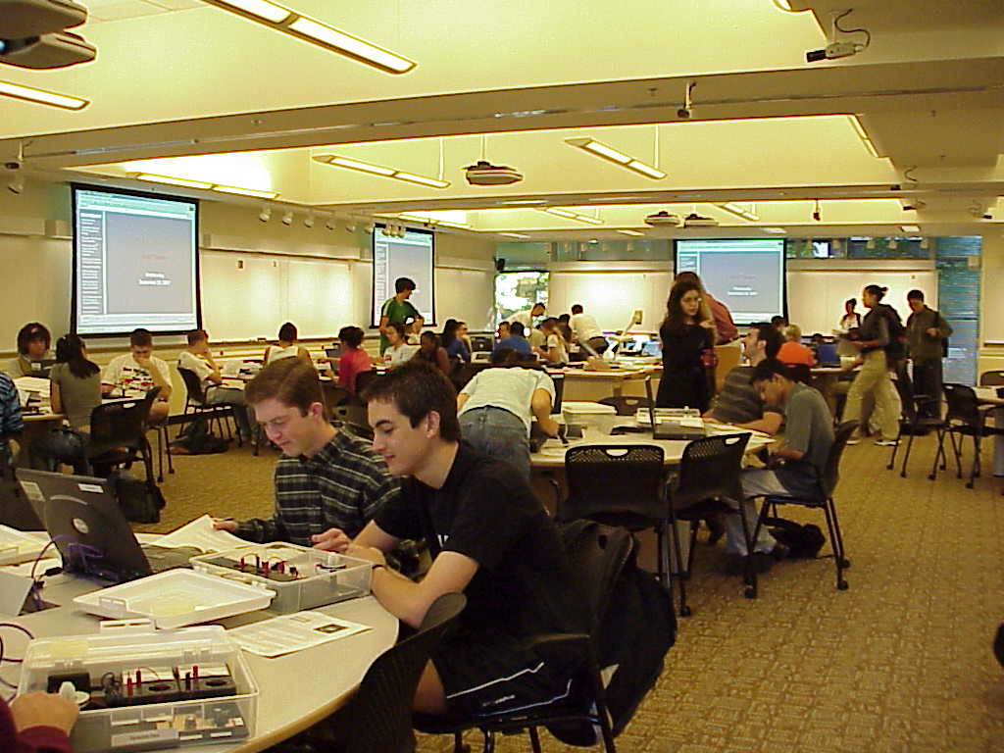
Active Learning (2 Exercises Per Lecture)

Slide 10

8 Programming Assignments

Slide 11
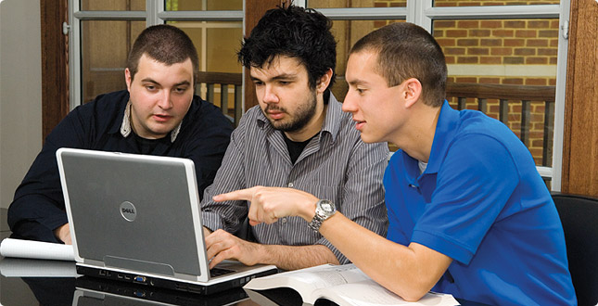
1 Team Final Project

Slide 12
Q & A

Slide 13

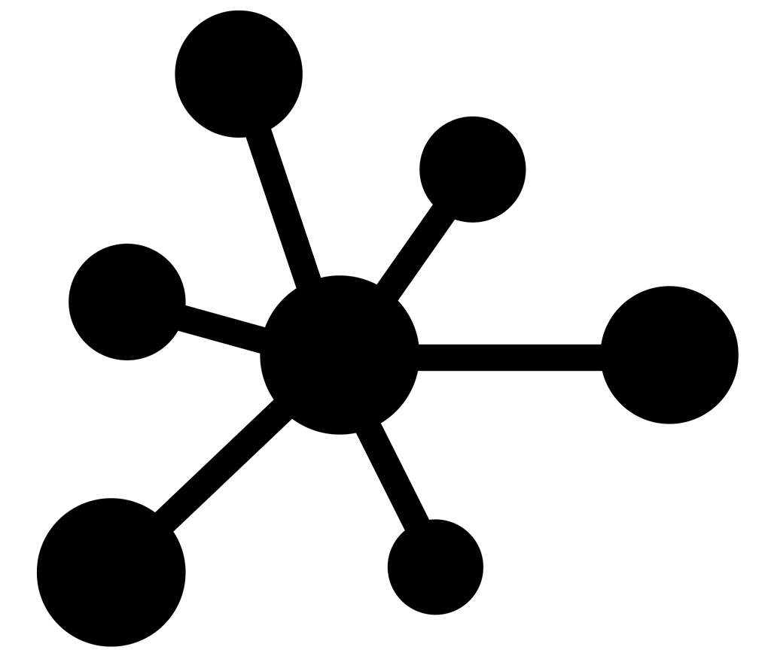

Computer Science
for(i=0; i<10; i++)
point[i]={x:i,y:i};
New Course:
1.001
Applied Computation
& Data Science
Applied
Computation
Engineering
Applied Science
Visualization
Applied Mathematics

Slide 14
Applied Computation and Data Science
Visualization
Asynchronous
Programming
Web Platform
Data Analysis
Graphical User Interfaces
Machine
Learning
1.001
Objects, Classes
Functions
Open Data
Model View Controller
Big Data
Mongo
Application
Servers
Node.js
Authentication
Authorization

